Slide 1
D* Lite
Part 2
n.h.reyes@massey.ac.nz

Slide 2
Objectives
Navigation in an Unknown Terrain
Learn D*Lite Basic Version
Learn D*Lite Final Version
Hand-simulation of an initial path-planning stage (final version of D*lite)
Hand-simulation of a replanning stage (final version of D*lite)
Mapping an unknown terrain
Assignment #1 Instructions
Start-up codes
Tutorial Questions

Slide 3
Mapping
an unknown terrain using D* Lite
Efficient Implementation of Greedy Mapping using D* Lite
Reference: M. Likhachev, S. Koenig, Lifelong Planning for Mobile Robots

Slide 4
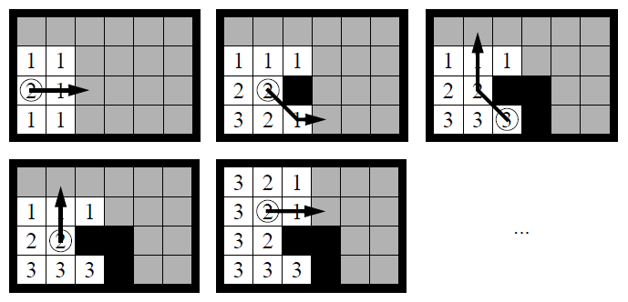
Greedy Mapping`
Greedy Mapping is a simple sensor-based planning method that discretizes terrain into cells and then always moves the robot on a shortest path to closest unobserved (or unvisited) cell, until the terrain is mapped.
sensors
Assumptions:
the location of the robot is always known (e.g. from GPS data).
There is neither position nor sensor uncertainty.
Sense environment
Calculate path
move
Notes:
GPS satellites are simply beacons, like lighthouses, that a device uses to calculate its own latitude and longitude. The satellites do not transmit any mapping information.

Slide 5
Greedy Mapping
Greedy Mapping is a simple sensor-based planning method that discretizes terrain into cells and then always moves the robot on a shortest path to closest unobserved (or unvisited) cell, until the terrain is mapped.
Assumptions:
the location of the robot is always known (e.g. from GPS data).
There is neither position nor sensor uncertainty.
Sense environment
Calculate path
move

Slide 6
Greedy Mapping
Greedy Mapping is a simple sensor-based planning method that discretizes terrain into cells and then always moves the robot on a shortest path to closest unobserved (or unvisited) cell, until the terrain is mapped.
Assumptions:
the location of the robot is always known (e.g. from GPS data).
There is neither position nor sensor uncertainty.
Sense environment
Calculate path
move

Slide 7
Greedy Mapping
Greedy Mapping is a simple sensor-based planning method that discretizes terrain into cells and then always moves the robot on a shortest path to closest unobserved (or unvisited) cell, until the terrain is mapped.
Assumptions:
the location of the robot is always known (e.g. from GPS data).
There is neither position nor sensor uncertainty.
move

Slide 8
Greedy Mapping
Greedy Mapping is a simple sensor-based planning method that discretizes terrain into cells and then always moves the robot on a shortest path to closest unobserved (or unvisited) cell, until the terrain is mapped.
Assumptions:
the location of the robot is always known (e.g. from GPS data).
There is neither position nor sensor uncertainty.
Sense environment
Calculate path
move

Slide 9
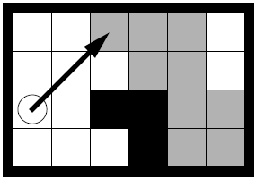
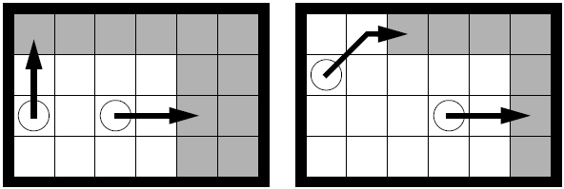
Greedy Mapping: Advantages
utilises prior map knowledge, if available
Can be used by multiple robots that share their maps

Slide 10
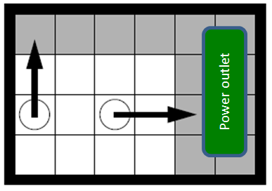
Greedy Mapping: Advantages
It is robust with respect to the inevitable inaccuracies and malfunctions of other architecture components. The algorithm does not need to have control of the robot at all times.
e.g. The robot may pre-empt the greedy mapping algorithm once it realises that its battery is running out. The robot may have to move towards a power outlet, re-charge then resume its mapping operation from there.

Slide 11
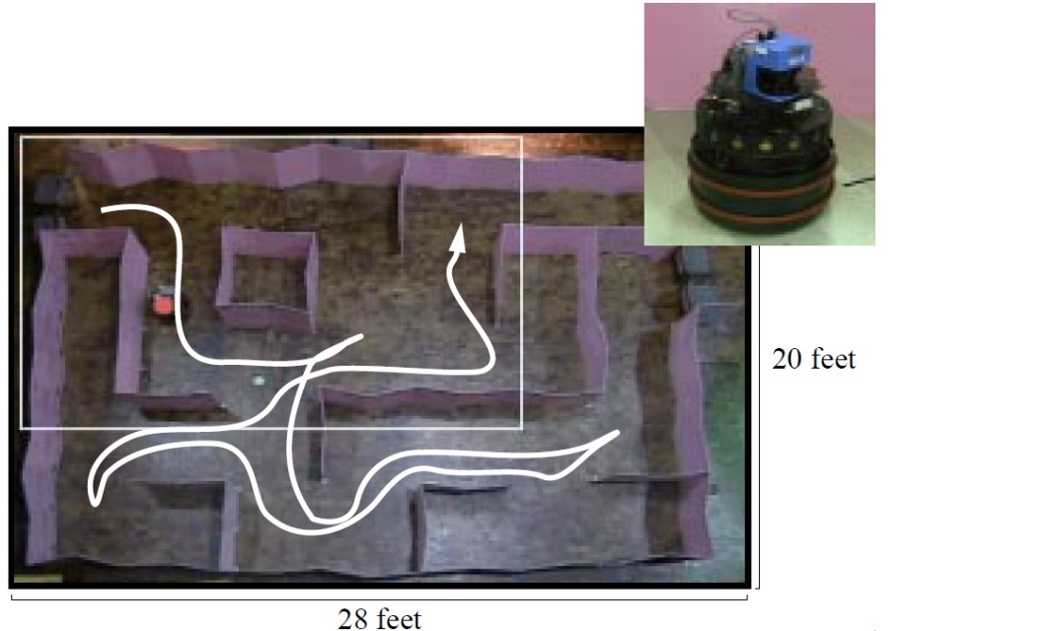
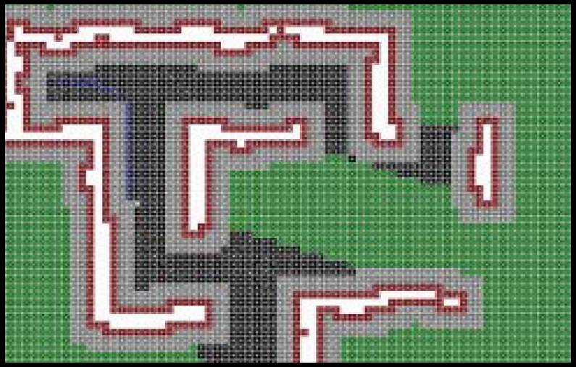
Greedy Mapping: Robot Implementation
obstacle
Sensor: Laser scanner (180 degree scan)
Cell size: 10cm x 10cm
free space
unknown
Greedy On-Line Planning, Sven Koenig, Georgia Tech; Jan. 2002
Notes:
The laser scanner is highly accurate and has sufficient resolution and range accuracy.

Slide 12
Closest Unobserved Cell
In order to apply an optimal path-planning algorithm with the greedy mapping algorithm, we need to find the closest unobserved cell first.
However, there are lots of unobserved cells. Do we need to calculate the shortest path to each and every one of them? Exactly, what is an efficient way of solving this problem?

Slide 13
Representation of Mapping as a Graph-Search Problem

Slide 14
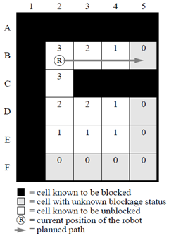
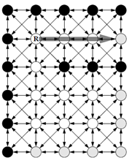
Greedy Mapping
Fig. 1. Example Mapping Task
1. Impose a regular 8-connected grid over a terrain.
Distance from closest unobserved cell
The robot only roughly knows the graph; initially, it does not know exactly which vertices are blocked.
Prior knowledge about the blockage status of cells are utilised.
Using an on-board sensor, the robot is able to tell the blockage status of cells within its vicinity.
Notes:
The robot knows the graph but initially does not know exactly which vertices are blocked.

Slide 15
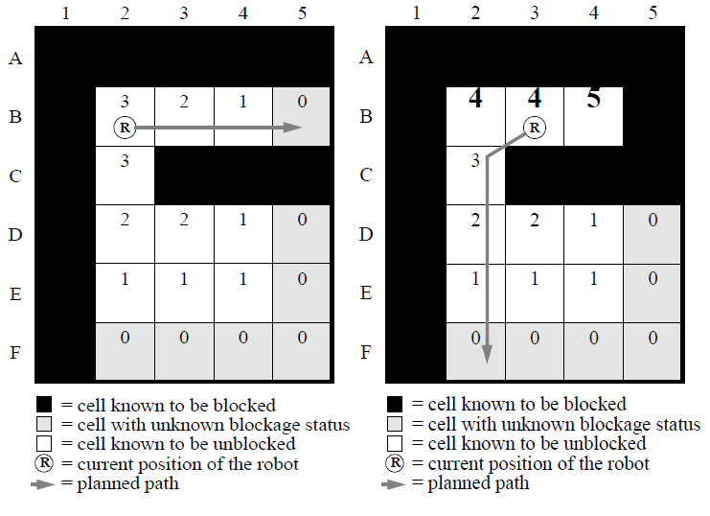
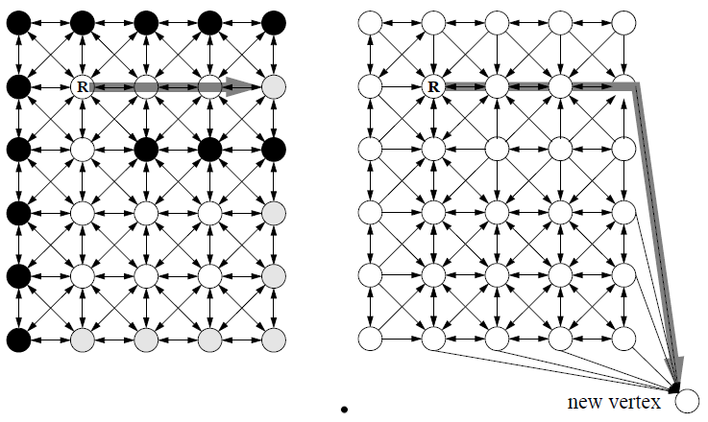
Greedy Mapping
Robot with a sensor range of 2 cells.
Fig. 1. Example Mapping Task
Whenever the robot gains information about the blockage status of vertices, the shortest potentially unblocked path from its current vertex to the closest vertex with unknown blockage status can change.
2. Let the robot gain new information as it moves. Perform course correction whenever necessary.
Fig. 2. Graphs for the Example Mapping Task

Slide 16
Greedy Mapping
Robot with a sensor range of 2 cells.
Fig. 1. Example Mapping Task
Whenever the robot gains information about the blockage status of vertices, the shortest potentially unblocked path from its current vertex to the closest vertex with unknown blockage status can change.
In this example, Greedy Mapping needs to recalculate a shortest potentially unblocked path to the closest vertex with unknown blockage status.
Fig. 2. Graphs for the Example Mapping Task

Slide 17
Greedy Mapping
Fig. 1. Example Mapping Task
Advantage of Using Incremental Search with Greedy Mapping
Reusing information from previous searches can potentially reduce the search time of heuristic search methods for Greedy Mapping.
When replanning the shortest path in Fig. 2 (right), D* Lite only expands 3 vertices whose distances to the closest cell with unknown blockage status have changed {namely B2, B3, and B4}.
Fig. 2. Graphs for the Example Mapping Task

Slide 18
Greedy Mapping
Fig. 1. Example Mapping Task
A* on the other hand expands 7 vertices {namely C2, D2, D4, D5, E2, E5, and F2} and thus is less efficient than D* Lite.
When replanning the shortest path in Fig. 2 (right), D* Lite only expands 3 vertices whose distances to the closest cell with unknown blockage status have changed {namely B2, B3, and B4}.
Fig. 2. Graphs for the Example Mapping Task

Slide 19
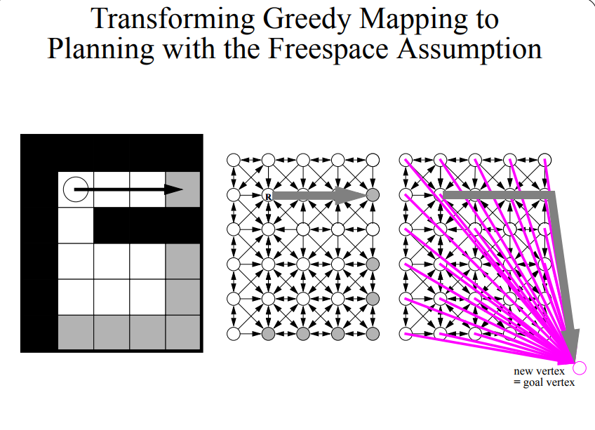

Slide 20
Efficient Implementation of Greedy Mapping using D* Lite
TECHNICAL DETAILS
Reference: M. Likhachev, S. Koenig, Lifelong Planning for Mobile Robots

Slide 21
Implementing Greedy Mapping using D* Lite
New vertex
Original Graph
Extended Graph
Introduce a new vertex, then construct an extended graph (Fig.2 , right).
Contains all edges from the original graph, except those edges that go from vertices that are known to be unblocked or potentially unblocked to vertices that are known to be blocked.
This ensures that the planned path cannot contain vertices that are known to be blocked, and thus is potentially unblocked.
Notes:
Prevent the robot from making paths that lead toward blocked cells by deleting all edges that lead toward block cells in the extended graph.

Slide 22
Implementing Greedy Mapping using D* Lite
New vertex
Original Graph
Extended Graph
Introduce a new vertex, then construct an extended graph (Fig.2 , right).
Contains all edges from the original graph, except those edges that go from vertices that are known to be unblocked or potentially unblocked to vertices that are known to be blocked.
This ensures that the planned path cannot contain vertices that are known to be blocked and thus is potentially unblocked.
The extended graph contains edges of the original graph that go from vertices that are known to be blocked to other vertices.
This is important in case the robot has mistakenly classified an unblocked vertex as blocked and then, due to actuator uncertainty, deviates from the planned path and reaches this vertex.
The robot believes that it can leave this vertex only if the edges of the extended graph that go from it to other vertices have not been deleted.
Notes:
Prevent the robot from making paths that lead toward blocked cells by deleting all edges that lead toward block cells in the extended graph.

Slide 23
Implementing Greedy Mapping using D* Lite
New vertex
Original Graph
Extended Graph
Create connections to the new vertex (Fig.2 , right).
Identify vertices with unknown blockage status that can be reached with one edge traversal from vertices with known blockage status.
Connect them all to the new vertex.
This ensures that the planned path reaches a vertex with unknown blockage status, and, from there, the new vertex.
Notes:
Prevent the robot from making paths that lead toward blocked cells by deleting all edges that lead toward block cells in the extended graph.

Slide 24
Implementing Greedy Mapping using D* Lite
R
New vertex
Original Graph
Extended Graph
Create connections to the new vertex (Fig.2 , right).
Identify vertices with unknown blockage status that can be reached with one edge traversal from vertices with known blockage status.
Connect them all to the new vertex.
This ensures that the planned path reaches a vertex with unknown blockage status, and, from there, the new vertex.
Figure on the right, shows a shortest potentially unblocked path on the extended graph. It runs from the current vertex of the robot to the new vertex. This corresponds to a shortest unblocked path on the original graph from the current vertex of the robot to a vertex with unknown blockage status, and vice-versa. Note that the new vertex is used to help find the shortest path to the closest vertex with unknown blockage. Therefore, D* Lite can be applied to the extended graph.
Notes:
Prevent the robot from making paths that lead toward blocked cells by deleting all edges that lead toward block cells in the extended graph.

Slide 25
Implementing Greedy Mapping using D* Lite
R
New vertex
Original Graph
Extended Graph
Figure on the right, shows a shortest potentially unblocked path on the extended graph. It runs from the current vertex of the robot to the new vertex. This corresponds to a shortest unblocked path on the original graph from the current vertex of the robot to a vertex with unknown blockage status, and vice-versa. Note that the new vertex is used to help find the shortest path to the closest vertex with unknown blockage. Therefore, D* Lite can be applied to the extended graph.
Note that the new vertex is only a virtual vertex. On the way to the new vertex, as soon as the robot steps into a cell with unknown blockage status, that is already the closest unobserved cell that we are looking for.
Notes:
Prevent the robot from making paths that lead toward blocked cells by deleting all edges that lead toward block cells in the extended graph.

Slide 26
Another Example: Greedy Mapping using D* Lite

Slide 27
Implementing Greedy Mapping using D* Lite
Fig. 1. Example Mapping Task
Fig. 2. Graphs for the Example Mapping Task
Introduce a new vertex, then construct an extended graph (Fig.2 , right).
Contains all edges from the original graph, except those edges that go from vertices that are known to be unblocked or potentially unblocked to vertices that are known to be blocked.
This ensures that the planned path cannot contain vertices that are known to be blocked and thus is potentially unblocked.
Notes:
Prevent the robot from making paths that lead toward blocked cells by deleting all edges that lead toward block cells in the extended graph.

Slide 28
Implementing Greedy Mapping using D* Lite
Fig. 1. Example Mapping Task
Fig. 2. Graphs for the Example Mapping Task
Introduce a new vertex, then construct an extended graph (Fig.2 , right).
(continuation…) The extended graph contains edges of the original graph that go from vertices that are known to be blocked to other vertices.
This is important in case the robot has mistakenly classified an unblocked vertex as blocked and then, due to actuator uncertainty, deviates from the planned path and reaches this vertex.
The robot believes that it can leave this vertex only if the edges of the extended graph that go from it to other vertices have not been deleted.
Notes:
Provide paths that will allow a robot to exit/escape from cells that are marked to be blocked (but in reality, a cell that is not actually blocked), in case a robot gets there accidentally

Slide 29
Implementing Greedy Mapping using D* Lite
Fig. 1. Example Mapping Task
Fig. 2. Graphs for the Example Mapping Task
Create connections to the new vertex (Fig.2 , right).
Connect to the new vertex edges that link vertices with unknown blockage status that can be reached with one edge traversal from vertices with known blockage status.
This ensures that the planned path reaches a vertex with unknown blockage status, and, from there, the new vertex.
Notes:
Connect the following cells to the NEW VERTEX:
- cells (with unknown blockage status) that are connected to cells with known blockage status
-This will allow paths towards the new vertex via unknown cells.

Slide 30
Implementing Greedy Mapping using D* Lite
Fig. 1. Example Mapping Task
Fig. 2. Graphs for the Example Mapping Task
Extended graph
Fig. 2, (right), shows a shortest potentially unblocked path on the extended graph. It runs from the current vertex of the robot to the new vertex. This corresponds to a shortest unblocked path on the original graph from the current vertex of the robot to a vertex with unknown blockage status, and vice-versa. Note that the new vertex is used to help find the shortest path to the closest vertex with unknown blockage. Therefore, D* Lite can be applied to the extended graph.

Slide 31
Greedy Mapping
DESIRABLE PROPERTIES
Greedy Mapping (GM) has the following desirable properties:
Theoretical Foundation – GM has a solid theoretical foundation that allows one to characterize its behaviour analytically. It is guaranteed to map terrain under realistic assumptions and its mapping time can be proved to be reasonably small.

Slide 32
Greedy Mapping
DESIRABLE PROPERTIES
Greedy Mapping (GM) has the following desirable properties:
Theoretical Foundation – GM has a solid theoretical foundation that allows one to characterize its behaviour analytically. It is guaranteed to map terrain under realistic assumptions and its mapping time can be proved to be reasonably small.
Simple Integration into Robot Architectures – robust with respect to the inevitable inaccuracies and malfunctions of other architecture components. It does not need to have control of the robot at all times, and can resume its operation from any location (in case the robot diverts from where Greedy Mapping expects it to move).

Slide 33
Greedy Mapping
DESIRABLE PROPERTIES
Greedy Mapping (GM) has the following desirable properties:
Theoretical Foundation – GM has a solid theoretical foundation that allows one to characterize its behaviour analytically. It is guaranteed to map terrain under realistic assumptions and its mapping time can be proved to be reasonably small.
Simple Integration into Robot Architectures – robust with respect to the inevitable inaccuracies and malfunctions of other architecture components. It does not need to have control of the robot at all times, and can resume its operation from any location (in case the robot diverts from where Greedy Mapping expects it to move).
Prior Knowledge – uses all of its knowledge about the terrain when it determines which unobserved cell is closest to the robot and how to get there quickly.

Slide 34
Greedy Mapping
DESIRABLE PROPERTIES
Greedy Mapping (GM) has the following desirable properties:
Theoretical Foundation – GM has a solid theoretical foundation that allows one to characterize its behaviour analytically. It is guaranteed to map terrain under realistic assumptions and its mapping time can be proved to be reasonably small.
Simple Integration into Robot Architectures – robust with respect to the inevitable inaccuracies and malfunctions of other architecture components. It does not need to have control of the robot at all times, and can resume its operation from any location (in case the robot diverts from where Greedy Mapping expects it to move).
Prior Knowledge – uses all of its knowledge about the terrain when it determines which unobserved cell is closest to the robot and how to get there quickly.
Distributed Search – multiple robots can each run Greedy Mapping and share their maps, thereby decreasing the mapping time. Cooperative mapping is currently a very active research area.

Slide 35
Conclusions
D* Lite is a fast re-planning method suitable for goal-directed robot navigation in unknown terrain as well as mapping an unknown terrain.
It implements the same navigation strategies as D*, and is at least as efficient as D*.

Slide 36
References
Anthony Stentz, Martial Hebert, A complete navigation system for goal acquisition in unknown environments. Auton. Robots 2(2): 127-145 (1995)
Joseph Carsten, Arturo Rankin, Dave Ferguson, Anthony Stentz, Global planning on the Mars Exploration Rovers: Software integration and surface testing. J. Field Robotics 26(4): 337-357 (2009)
S. Koenig, W. Yeoh, Project on Fast Trajectory Replanning for Computer Games
S. Koenig and M. Likhachev. Fast Replanning for Navigation in Unknown Terrain. Transactions on Robotics, 21, (3), 354-363, 2005.
S. Koenig and M. Likhachev. D* Lite. In Proceedings of the AAAI Conference of Artificial Intelligence (AAAI), 476-483, 2002.
M. Likhachev, S. Koenig, Lifelong Planning for Mobile Robots
http://idm-lab.org/publications.html
http://idm-lab.org/project-a.html
http://homepages.dcc.ufmg.br/~lhrios/applet_d_lite/index.html
A complete navigation system for goal acquisition in unknown environments, Anthony Stentz and Martial Hebert
BUCKET sort: https://www.cs.cmu.edu/~adamchik/15-121/lectures/Sorting%20Algorithms/sorting.html
Bucket sort: https://www-927.ibm.com/ibm/cas/hspc/student/algorithms/BucketSort.html
Extra:
http://idm-lab.org/bib/abstracts/papers/aaai08-education.pdf
http://dspace.mit.edu/bitstream/handle/1721.1/36832/16-412JSpring2004/NR/rdonlyres/Aeronautics-and-Astronautics/16-412JSpring2004/8A4AE5FE-F1E8-4BE2-9014-18E466AEA141/0/l5acnstrintrplan.pdf
http://www.cs.berkeley.edu/~pabbeel/cs287-fa13/slides/Likhachev_robschooltutorial_oct10.pdf

Slide 37
Possible Path-Planning Topics for Seminar Presentations
A. Nash and S. Koenig. Any-Angle Path Planning. Artificial Intelligence Magazine, 34, (4), 85-107, 2013.
K. Daniel, A. Nash, S. Koenig and A. Felner. Theta*: Any-Angle Path Planning on Grids. Journal of Artificial Intelligence Research, 39, 533-579, 2010.
X. Sun, W. Yeoh and S. Koenig. Moving Target D* Lite. In Proceedings of the International Joint Conference on Autonomous Agents and Multiagent Systems (AAMAS), 67-74, 2010.
C. Hernandez, X. Sun, S. Koenig and P. Meseguer. Tree Adaptive A*. In Proceedings of the International Joint Conference on Autonomous Agents and Multiagent Systems (AAMAS), 123-130, 2011.
R. Borie, C. Tovey and S. Koenig. Algorithms and Complexity Results for Graph-Based Pursuit Evasion. Autonomous Robots, 31, (4), 317-332, 2011.
M. Cirillo, F. Pecora, H. Andreasson, T. Uras and S. Koenig. Integrated Motion Planning and Coordination for Industrial Vehicles. In Proceedings of the International Conference on Automated Planning and Scheduling (ICAPS), 2014.

Slide 38
The End.

